Slide 1
Project update
Wei Fan

Slide 2
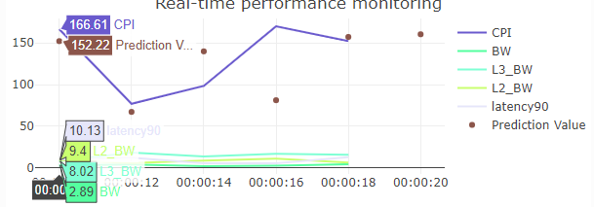
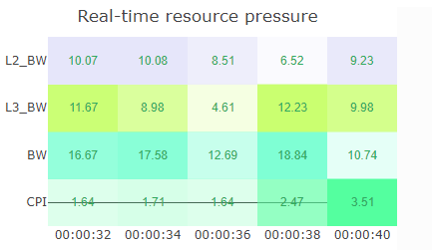
View
Encodings:
x: time series
Y: quantity data
Color: system metrics
Mark: line/point
X:time series
Y/Color: system metrics
Value/illuminate: quantity
Notes:
These two views are linked for monitoring real time system resource stress and application performance. Latency 90 is what we have to evaluate an application’s performance. And prediction value is applied on latency 90. Because I use mock data here so the prediction result is not good. The two views will be flashed each 2 seconds. And the color, time are all binding to each other.

Slide 3
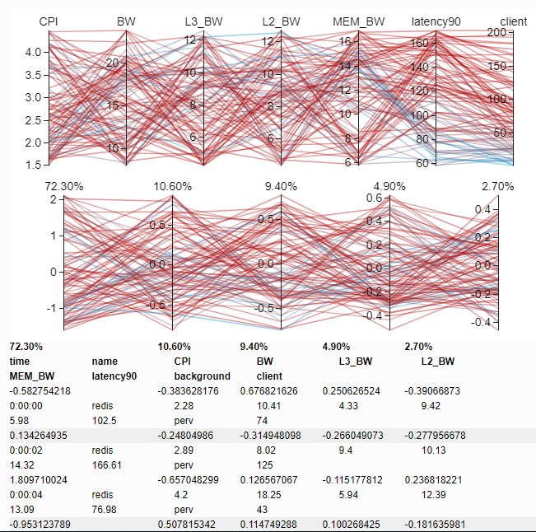
View
Original data view
Eigenvector view
Data table
Notes:
These three views are also linked to give an insight of PCA result.

Slide 4
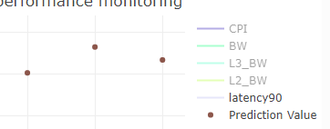
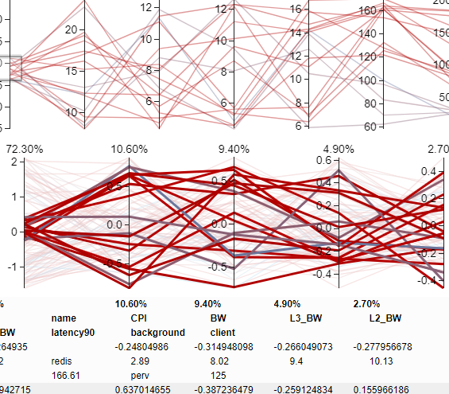

Interactions
In-graph
Zoom/ select
Linked graph
Highlight/ update
Notes:
The in-graph interaction is like zoom in or out and select if this feature is to shown.
The overall interaction, I made dropboxes for user to pick up the target application’s name, metrics and prediction algorithm. Every time a user submit this choice, all plots are updated.
And I made the 2 parallel and one table to be linked with highlighting lines or updating table data.

Slide 5
TODO list
Detail problems(legends, labels, layouts)
2-D projection plot
RNN training
Notes:
I choose to do all detail problems in the last update because the layout and design of my plots changes a lot because I use mockup data this time, the real data might change and I might be add or remove some plots or do data-ink to insert more encodings into one plot.
And the 2-D projection plot, which represents the best for PCA result, I will be adding it, along with the clustering result by next update.
I do linear regression for prediction this time and I will do RNN for alternative algorithms requirement when I get the real data.

Slide 6
Demo
video

